Slide 1

Paper ID: 86
Efficient Noise Reduction and HOG Feature Extraction for Sign Language Recognition
Presented By
Tasnim Tabassum
and
Iqbal Mahmud
Student, Dept. of CSE
HSTU, Dinajpur-5200
International Conference on Advancement in Electrical and
Electronic Engineering - (ICAEEE 2018)
Dhaka University of Engineering & Technology (DUET), Gazipur
23 November, 2018

Slide 2
Outlines
Introduction
Sign Language
How Sign Language Recognition Works?
Why Sign Language Recognition?
Objectives
Background Study
Available Techniques
Related Works
Proposed System
Motivation for Work
Block Diagram and Flow Chart
Experimental Result
Datasets
Image Preprocessing
Feature Extraction
Recognition
Test Results & Evaluation of Test Result
Conclusion an Future Plan
References

Slide 3
Introduction
Sign Language
What is sign language?
Users of this language
How Sign Language Recognition Works?
Shape of hand and position of various manual and non-manual features
Obtaining features
Classifying signs with the features
Why Sign Language Recognition?
Communication with signers

Slide 4
Objectives
To remove noises from background
Detect one handed signs
Extract HOG features from hand shapes
Recognize the signs through KNN classifier

Slide 5
Background Study
Available Techniques for Sign Language Recognition
Hidden Markov Model
Normalized Cross Correlation
Color Based Image Segmentation
Bag of Features
K-means Clustering etc.

Slide 6
Background Study (Cont’d)
Authors | Title of Paper | Methodologies | Detected Sign Language
Kaushik Deb, Helena Parvin Mony & Sujan Chowdhury | Two-Handed Sign Language Recognition for Bangla Character Using Normalized Cross Correlation | Normalized Cross Correlation | Bengali
Sakshi Goyal, Ishita Sharma, Shanu Sharma | Sign Language Recognition System For Deaf And Dumb People | SIFT (Scale Invariance Fourier Transform) algorithm. | Indian
Md. Atiqur Rahman, Ahsan-Ul-Ambia and Md. Aktaruzzaman | Recognition Static Hand Gestures of Alphabet in ASL | Artificial Neural Network (ANN) | American

Slide 7
Proposed System
Motivation
Ease of communication between hearing and speech impaired people and the people who do not understand the sign language
The Proposal
Preprocess the images
Extract the features
Train the Classifier
Recognition of signs

Slide 8
Proposed System (Cont’d)
Proposed system block diagram
Input Image (RGB)
Noise Filter
Image Segmentation
Convert to binary
Target Matrix
Input Matrix
Extract HOG Features
Detect Canny Edges
Classify with KNN classifier
Recognized Sign

Slide 9
Proposed System (Cont’d)
Flowchart of the proposed system
Start
Input Image
Preprocess Image
Detect Canny Edges from Binary Images
Extract Features from Different Images and Separate Them
Classification and Recognition by KNN
Show the Recognized Signs
End

Slide 10
Experimental Result
Database
Dataset | Signs | Number of Images | Resolution | Pixel values | Image Types
Training Set | A to Z | 14 | 200*200*3 | Unit8 | Jpg
Test Set | A to Z | 8 | 200*200*3 | Unit8 | Jpg

Slide 11
Experimental Result (Cont’d)
Transformed Image after Logarithmic Plot Transformation

Slide 12
Experimental Result (Cont’d)
Image after Histogram Equalization and Segmentation using L*a*b Color Space

Slide 13
Experimental Result (Cont’d)
Detected Canny Edges

Slide 14

Experimental Result (Cont’d)
Extracted HOG Features

Slide 15
Experimental Result (Cont’d)
Recognition of some signs

Slide 16
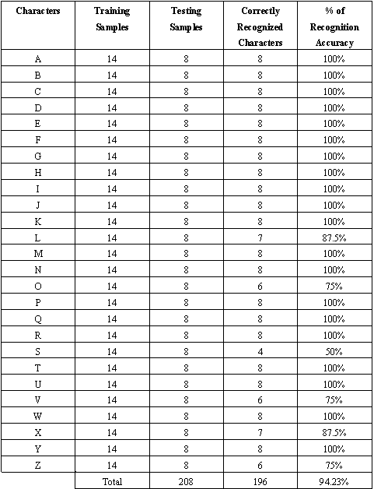
Experimental Result (Cont’d)
Test result

Slide 17
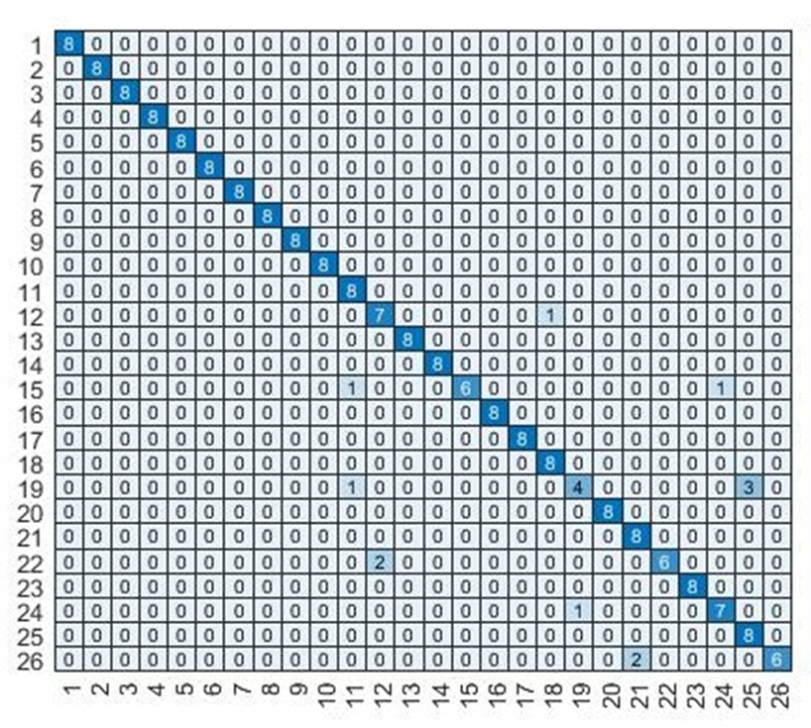
Experimental Result (Cont’d)
Evaluation of Result
Accuracy of the System for Confusion Matrix for Test Set
Training and Test Set for Both Models

Slide 18
Conclusion and Future Plan
The overall idea behind this research was to reduce the communication gap between hearing and speech impaired people and the rest
Other feature extraction and classification methods need to be implemented and integrated with this model to make this even more efficient and real time based.
Our future plan is to implement this research for
Bengali Sign Language Recognition
Data other than alphabets
Real time based sign recognition

Slide 19
Key References
V. E. Kosmidou, and L. J. Hadjileontiadis, “Sign Language Recognition Using Intrinsic-Mode Sample Entropy on EMG and Accelerometer Data,” IEEE Transactions on Biomedical Engineering, vol. 56, no. 12, Dec. 2009.
R. Parton, B. Sue, "Sign Language Recognition and Translation: A Multidisciplined Approach from the Field of Artificial Intelligence," Journal of Deaf Studies and Deaf Education, vol. 11, no. 1, 2005.
Lang, Simon, “Sign Language Recognition with Kinect,” Institute for Informatics Freia University Berlin, Berlin: Freia University Berlin, 2011.
Parton, B. Sue, "Sign Language Recognition and Translation: A Multidisciplined Approach from the Field of Artificial Intelligence," Journal of Deaf Studies and Deaf Education, vol. 11, no. 1, 2005.
Unnamed, “Scientific Understanding and Vision Based Technological Development for Continuous Sign Language Recognition and Translation,” Sign-Speak Project, Annual Public Report. [Online].Available:http://www.signspeak.eu/
L. Christopher and Y. Xu, "Online, interactive learning of gestures for human/robot interfaces," IEEE International Conference on Robotics and Automation, vol. 4, 1996.
D. S. Hossain, T. Mustafiz, A. I. Sarkar, M. Rokonuzzaman, “Geometrical Model Based Hand Gesture Recognition for Interpreting Bengali Sign Language Using Computer Vision,” IEEE International Conference on Computer and Information Technology (ICCIT), 2003.
Wan-Yi Yeh, Teng-Hui Tseng, Jun-Wei Hsieh, Chun-Ming, “Sign language recognition system via Kinect: Number and english alphabet,” International Conference on Machine Learning and Cybernetics (ICMLC), 2016
M. Akash, “Image data set for alphabets in the American Sign Language,”[Online]. Available: https://www.kaggle.com/grassknoted/asl-alphabet
S. Wang, J. Zheng, H. Hu, and B. Li, “Naturalness preserved enhancement algorithm for non-uniform illumination images,” IEEE Trans. Image Process., vol.22, no. 9, Sept. 2013.
R. Gonzalez and R. Woods, “Digital Image Processing,” Addison-Wesley Publishing Company, pp. 167 – 168, 1992.
M. Dan, “Photoshop Lab Color: The Canyon Conundrum and Other Adventures in the Most Powerful Color space,” Berkeley, Calif.: London: Peach pit; Pearson Education, 2006.
C. Chen, “Computer image processing technology and algorithms,” Beijing: Tsinghua University Press, 2003.
N. Dalal and B. Triggs, “Histograms of Oriented Gradients for Human Detection,” IEEE Computer Society Conference on Computer Vision and Pattern Recognition (CVPR’05), vol. 2, pp. 886-893, 2005.

Slide 20
Thank You

